Slide 1
Securing User Accounts in Linux Session 2
Course : COMP6827001 - Linus Systems Administration and Security
Ivan Sebastian Edbert

Slide 2
Learning Objectives
At the end of this session, the student will be expected to :
Able to explain about Linux Security
Able to manage User Security in Linux
Understand the implementation of SSH Access

Slide 3
Outline
Root Account
Managing User Security
Restrict SSH Access
Account Privilages

Slide 4

Linux Security
Linux Security refers to the practices and measures implemented to protect Linux-based operating systems from security threats and vulnerabilities. As an open-source and widely used operating system, Linux is a popular target for attackers, making security an important aspect for system administrators and users.

Slide 5
Root Account

Slide 6
Root Account
The root account in Linux is a special user account with administrative privileges. It is also known as the superuser account or the system administrator account. The root user has complete control over the operating system and can perform any action on the system, including modifying critical system files, installing software, and managing user accounts.
Similar to “administrator user” on Windows
The difference is that Windows has security practices on User Access Control (UAC), while Linux doesn’t have that
Therefore, it is very dangerous to access root account

Slide 7
Risk of Using Root Account
Example: Getting malware in the computer
When using root account, since you have access to all files, the malware too can read and damage all the files
When using limited account, since access is limited, the malware can’t reach central system and therefore the damage can be partially mitigated
Remember, the root account should be used judiciously and only for necessary administrative tasks. Careless use or misuse of the root account can have severe consequences and may compromise the security and stability of the Linux system.

Slide 8
sudo
A special command in Linux that allows user to execute command with the privilege of another user (usually the root)
This way an user can execute restricted commands without moving to root user
Executing sudo commands will prompt a password check
sudo command can be granted to selected user only, primarily admin accounts
If non-sudo account access sudo command, it will be logged as a security event

Slide 9
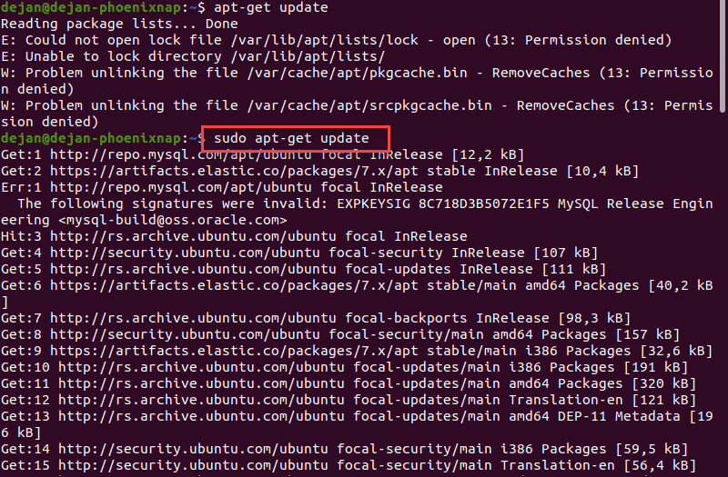
sudo

Slide 10
Managing User Account Security

Slide 11
Managing User Account Security
Managing user account security in Linux is an important aspect of maintaining a secure system. Here are some key considerations and practices for managing user account security:
When adding new user make sure they have only the necessary privileges
Disable root login to prevent breaches
Password policies: enforce password pattern to ensure strong strength
Use two factor authentication
Do Regular Auditing and monitoring
Educate the users to enhance the awareness of the user

Slide 12
Managing Groups
Managing groups in Linux is an important aspect of user and permission management. Groups allow you to organize users with similar access requirements and simplify the process of granting permissions and managing file access.
It's more efficient to group user accounts with similar access requirements than to manage permissions on a user-by-user basis. Therefore, sysadmins need to be comfortable with the process of creating, modifying, and deleting groups.

Slide 13
Managing Groups
Understand the /etc/group file
→ Similar to the /etc/passwd file above, the /etc/group file contains group account information. This information can be essential for troubleshooting, security audits, and ensuring users can access the resources they need.
Create, modify, and delete groups
→ Like the user account commands described above, the group management commands are very intuitive and provide a lot of flexibility. There is an easy-to-remember command for each function you might need to carry out for a group:
groupadd
groupmod
Groupdel

Slide 14
Managing Groups
Manage group membership
Adding users to a group simplifies permissions management. Many people find the process a little unintuitive: Adding a user to a group modifies the user, not the group. Therefore, the necessary command is the usermod command.
→ Here are some commands to display group information:
usermod: Update group membership
id: Display a list of groups the user is a member of
cat /etc/group: Show a list of existing groups, with membership displayed in the last field

Slide 15
Restrict SSH Access

Slide 16
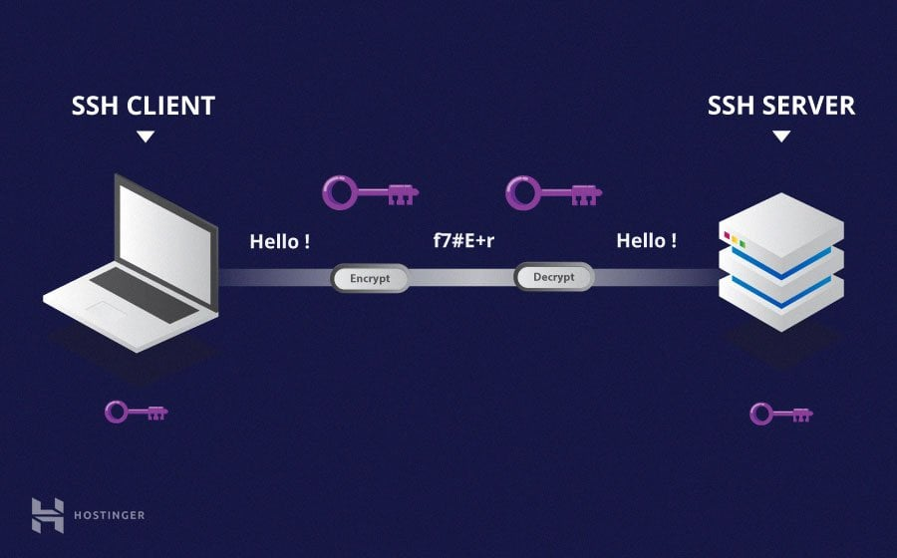
SSH (Secure Shell)
SSH (Secure Shell) is a network protocol used for secure remote access and communication between devices over an unsecured network. It provides a secure channel for executing commands, transferring files, and managing remote systems.

Slide 17
Restrict SSH access in Linux
Encryption: SSH encrypts all communication between the client and the server, including login credentials, commands, and data transfers. This ensures that the information exchanged is protected from unauthorized access.
Authentication: SSH uses various methods for user authentication, including passwords, public key cryptography, and certificate-based authentication. Public key authentication is widely used and involves generating a key pair (public key and private key), where the public key is stored on the server and the private key is securely kept by the user.

Slide 18
Restrict SSH access in Linux
Secure Remote Shell: SSH provides a secure remote shell environment, allowing users to log in and access a remote system's command-line interface. This enables remote administration and execution of commands on remote systems.
Port Forwarding: SSH supports port forwarding, which allows secure tunneling of network connections between the client and the server. It enables accessing services or resources on a remote network as if they were local.

Slide 19
Restrict SSH access in Linux
File Transfer: SSH includes utilities like SCP (Secure Copy) and SFTP (Secure File Transfer Protocol) for secure file transfers between systems. These utilities provide encryption and data integrity during file transfers.
X11 Forwarding: SSH supports X11 forwarding, allowing graphical applications to be run on a remote server and displayed on the client's system. This enables running graphical programs remotely without the need for a full remote desktop environment.

Slide 20
Restrict SSH access in Linux
Proxying: SSH can act as a secure proxy, forwarding network connections through an encrypted tunnel to access remote resources securely.
Portability: SSH is widely supported across different operating systems, including Linux, macOS, and Windows. There are various SSH client and server implementations available, such as OpenSSH, PuTTY, and WinSCP.

Slide 21
SSH Management
Limit the user’s connection into the server by using OpenSSH
Works like granting sudo access
Create group: sudo groupadd sshusers
Add user to the group: sudo gpasswd –a <username> sshusers
Configure: sudo nano (or vi) /etc/ssh/ssh_config
Add into config file: AllowGroups sshusers
Restart the SSH server: sudo service ssh restart

Slide 22
Account Privilages

Slide 23
Understanding Account Privileges
As stated, user should only be allowed to the only necessary files to support their work. Allowing user to access too much can lead to disaster.
It is important to control what an user can and can’t do
Some important practices to ensure security:
Manage Linux user account: managing beyond user account but also functional, system, and application accounts
Reducing privileges: follow the principle of least privilege, which revolves around the necessity of accessing root account
Managing password: enforce a good password practice via password policies, change frequently

Slide 24
Understanding Account Privileges
Reduce the use of shared account to a minimum even zero sharing. This is to ensure each user activities can be logged and traced if something wrong happens
Control access to the server, do not grant everyone all the access to any server from anywhere
Maintain logs as part of auditing
Record and manage privileged activities, since privileged accounts are more prone to breaches
Notify or alert in case of suspicious activity so that immediate response can be deployed
Unify and centralize management by using tools to manage access control, account management, and privilege management

Slide 25
References
Vickler, Andy. (2021, March 22). Linux: Linux Security and Administration.
https://www.ibm.com/docs/en/aix/7.2?topic=passwords-root-account
https://tldp.org/LDP/lame/LAME/linux-admin-made-easy/root-account.html
https://www.redhat.com/sysadmin/linux-user-group-management

Slide 26
Thankyou

